Slide 1



DERIVATIVES - SWAPS

Slide 2

DISCLAIMER
The training content and delivery of this presentation is confidential, and cannot be recorded, or copied and distributed to any third party, without the written consent of Imarticus Learning Pvt. Ltd.

Slide 3









YOU ARE GOING TO LEARN…
Introduction to Swaps
Features & Purpose of Swaps
Types of Swaps
Interest Rate Swap
Equity Swap
Total Return Swap
Dividend Swap
Credit Default Swap

Slide 4

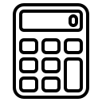

A SWAP AGREEMENT
Swap Agreement
The date when the cash flow has to be paid
The way the cash flows are accrued and calculated
SWAP is an OTC Derivative Contract wherein the Two Counterparties agrees to exchange the series of cashflows calculated on on two different underlying assets performance on preagreed Notional Amount and this cashflows are exchange on multiple settlement dates over the life of the Swap
‹#›

Slide 5


UNDERLYERS IN A SWAP AGREEMENT
Two counterparties exchange cash flows based on an underlier.
Cashflow based on Underlier-1
Cashflow based on Underlier-2
First Party
Second Party
Equities
Commodities
Credit Risk
Currencies
Interest Rate

Slide 6

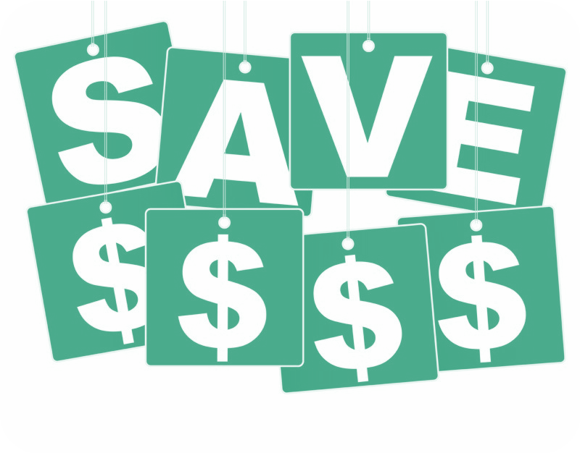
REASONS FOR TRADING IN SWAPS
Why do people trade in swaps?
HEDGE RISK
SPECULATION

Slide 7

Introduction and Types of Swaps

Slide 8
TYPES OF SWAPS
Interest Rate Swap
Types Of Swap
FX Swap
Equity Swap
Credit Default Swap

Slide 9
TYPES OF SWAPS
Types of Swap
Equity Swap
Interest Rate Swap
Credit Default Swap
Exchange of cash flows between two parties wherein one leg of the cash flow is calculated based on return on Equity (stock or Index) and the other leg is based on interest rates.
Exchange of cash flow between two parties, wherein both the legs of the cash flows are based on interest rates.
Exchange of cash flow between two parties, wherein one party pays premiums to buy protection from the seller against a reference entity. The seller of the protection will make the CDS payment in case of a credit event on the reference entity.

Slide 10
Interest Rate Swap

Slide 11
INTEREST RATE SWAP (IRS)
An interest rate swap (IRS) is a financial derivative contract between two parties that involves the exchange of interest rate cash flows. In an interest rate swap, one party typically pays a fixed interest rate while the other party pays a variable (floating) interest rate. These swaps are used primarily to manage interest rate risk, reduce borrowing costs, or speculate on interest rate movements.
Types of Interest Rates
Fixed Interest Rate
A fixed interest rate, also known as a fixed-rate, is an interest rate that remains constant throughout the specified period of a financial transaction or investment. In other words, it does not change over time, regardless of market interest rate fluctuations. Fixed interest rates are commonly used in various financial products, such as loans, bonds, and certain types of investments.
Explanation:
A fixed interest rate is set at the beginning of a financial arrangement and remains the same for the entire duration of that arrangement.
This means that the borrower or investor knows exactly how much interest they will pay or earn over the life of the transaction, providing predictability and stability in cash flows.
01

Slide 12
SWAPS
Floating Rate
A floating rate, also known as a variable rate or adjustable rate, is an interest rate that can change periodically based on a reference benchmark or index. Unlike a fixed interest rate, which remains constant over the life of a financial product, a floating rate adjusts to reflect current market conditions. Floating rates are commonly used in various financial products, such as adjustable-rate mortgages, floating-rate bonds, and certain types of loans. Here's a simple explanation and an example of a floating interest rate:
Explanation:
A floating interest rate is not fixed but rather fluctuates in response to changes in a specified benchmark interest rate or index.
The rate adjustment typically occurs at predetermined intervals, such as monthly, quarterly, or annually.
Borrowers or investors with floating-rate products are exposed to changes in market interest rates, which can result in varying interest payments or returns.
02

Slide 13





USES OF IRS
Portfolio Management
Speculation
Corporate Finance
Risk Management
Rate-locks on Bond Issuance

Slide 14
INTEREST RATE SWAPS: KEY TERMS
Trade Date | Date on which the trade is agreed
Effective Date | Date from which the Swap is Effective
Reset Frequency | How often will the Interest rates be re-calculated
Reset Date | The Date on which the Interest Rates are ‘recalculated’ or ‘readjusted’ to the market rates
Payment Date | Date on which the funds are exchanged
Termination Date | The last reset date of the swap
Term | The time period of a swap
Notional | The amount on which the cash-flows are calculated

Slide 15
IRS
Let’s use this Example of IRS - No need to differentiate between Hedging and Speculation.
In this example, we'll consider a hypothetical IRS between General Motors and IBM Corpn.
Parties Involved:
Company General Motors (Fixed-Rate Payer)
Company IBM Corpn (Floating-Rate Payer)
Terms of the IRS:
Notional Principal Amount: 10 million $
Fixed Interest Rate (Company General Motors): 4.5% per annum
Floating Interest Rate (Company IBM Corpn): 6-Month SOFR* + 2% (Floating Rate Benchmark)
Payment Frequency: Semi-Annual
Term of the Swap : 2 Years
*SOFR - Secured Overnight Financing Rate ; an US Benchmark Floating Interest rate

Slide 16
IRS
IRS Timeline: 2 years
Let's assume hypothetical 6-Month SOFR Benchmark Interest rates for each half-year and calculate the cash flows for both Company General Motors (Fixed-Rate Payer) and Company IBM Corpn (Floating-Rate Payer) in our 2-year Interest Rate Swap (IRS). For this example, we'll use the following hypothetical 6-Month SOFR rates:
Year 1 - H1 : 6-Month SOFR = 3.0%
Year 1 - H2 : 6-Month SOFR = 2.2%
Year 2 - H1 : 6-Month SOFR = 2.5%
Year 2 - H2 : 6-Month SOFR = 2.8%

Slide 17
IRS
Year 1 - 30th June:
Fixed Interest Payment (Company Gen Motors): ($10,000,000 * 4.5% / 2) = $225,000 (fixed)
Floating Interest Payment (Company IBM Corpn): (3.0% + 2%) / 2 = 2.5% * ($10,000,000) = $250,000
Year 1 - 31st Dec:
Fixed Interest Payment (Company Gen Motors): ($10,000,000 * 4.5% / 2) = $225,000 (fixed)
Floating Interest Payment (Company IBM Corpn): (2.2% + 2%) / 2 = 2.1% * ($10,000,000) = $210,000
Year 2 - 30th June:
Fixed Interest Payment (Company Gen Motors): ($10,000,000 * 4.5% / 2) = $225,000 (fixed)
Floating Interest Payment (Company IBM Corpn): (2.5% + 2%) / 2 = 2.75% * ($10,000,000) = $275,000
Year 2 - 31st Dec:
Fixed Interest Payment (Company Gen Motors): ($10,000,000 * 4.5% / 2) = $225,000 (fixed)
Floating Interest Payment (Company IBM Corpn): (2.8% + 2%) / 2 = 2.9% * ($10,000,000) = $290,000

Slide 18
IRS
Now, let's calculate the cash flows for each year:
Settlement | Gen Motors Payments | IBM Corpn Payments | Net Settlement Amount
Date of Settlement | Fixed Interest Rate Payments Payment @4.5% p.a Notional Amt x Int Rate | Floating Interest Rate Payments 6m SOFR + 2% Notional Amt x Floating Rate | Net Settlement Amount between the Parties
30th June 20X1 | 225000 US$ | 250000 US$ | (250000-225000) IBM Corpn Pays 25000 US$ to Gen Motors
31st Dec 20X1 | 225000 US$ | 210000 US$ | (225000-210000) Gen Motors Pays 15000 US$ to IBM Corpn
30th June 20X2 | 225000 US$ | 275000 US$ | (275000-225000) IBM Corpn Pays 50000 US$ to Gen Motors
31st Dec 20X2 | 225000 US$ | 290000 US$ | (290000-225000)
 |  |  | IBM Corpn Pays 65000 US$
 |  |  | to Gen Motors
In this table:
Company GM Motors (Fixed-Rate Payer) pays a fixed interest rate of $225,000 every six months.
Company IBM Corpn (Floating-Rate Payer) pays a floating interest rate based on the 6-Month SOFR rates plus the 2% spread.

Slide 19
TYPES OF INTEREST RATE SWAP
Floating for floating or ‘Basis’ swaps
Types of IRS
Involves the exchange of a floating interest payment vs. a floating interest payment
Fixed for floating or ‘vanilla’ swaps
Involves the exchange of a fixed interest payment vs. a floating interest payment

Slide 20
ILLUSTRATION ON TIMELINE OF AN IRS
1
2
3
4
5
Trade Date
Effective Date
1st April 20X1
1st October 20X1
Payment of 1st Reset
1st April 20X2
Payment of 2nd Reset
1st October 20X2
Payment of 3rd Reset
1st April 20X3
Termination Date

Slide 21
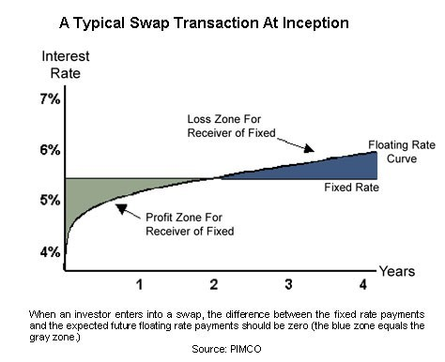
RISKS ASSOCIATED WITH IRS
Profit when Interest Rates Fall
Profit when Interest Rates Rise
Loss when Interest Rates Rise
Loss when Interest Rates Fall
Fixed Interest Rate Receiver
Fixed Interest Rate Payer
Primary Risks
Counterparty’s Credit Risk
Interest Rate Risk
The chance that the other party in the contract will default on its responsibility.
Credit Risk (Counterparty Risk)

Slide 22
Equity Swap

Slide 23
EQUITY SWAPS
An Equity Swap is a financial derivative contract in which two parties agree to exchange the cash flows associated with two different financial instruments, typically related to equities (stocks) or equity indices. The primary purpose of an Equity Swap is to transfer or swap the risks and returns of the underlying assets between the counterparties without actual ownership or transfer of those assets. Equity Swaps are commonly used for various purposes, including hedging, speculation, and portfolio management.
The key components and features of an Equity Swap:
1. Counterparties: Two parties, often referred to as the "fixed leg" and the "floating leg," enter into the swap agreement.
2. Underlying Assets: The swap is based on the performance of underlying assets, which can include individual stocks, stock indices, or baskets of stocks.

Slide 24
EQUITY SWAPS
3. Notional Principal: Like other types of swaps, Equity Swaps involve a notional principal amount. However, this amount is not exchanged between the parties; it serves as the reference point for calculating cash flows.
4. Payment Frequency: Cash flows in Equity Swaps can be structured to occur at various intervals, such as quarterly or annually.
5. Termination Date: The swap agreement specifies the termination date or maturity date of the contract when the final exchange of cash flows occurs.
6. Cash Flows:
The "fixed leg" party typically agrees to pay a fixed interest rate or return to the other party.
The "floating leg" party agrees to pay the returns generated by the underlying assets, which can include dividends, capital gains/losses, or interest income.

Slide 25
EQUITY SWAPS
Equity Swaps can serve several purposes, including:
01
Hedging: Investors can use Equity Swaps to hedge against the risk associated with their equity holdings. For example, if an investor owns a portfolio of stocks and wants to protect against a potential decline in their value, they can enter into an Equity Swap that pays them the return of the portfolio in exchange for a fixed payment.
02
Portfolio Replication: Asset managers and institutional investors can use Equity Swaps to replicate the performance of a specific stock index or benchmark without actually buying all the individual stocks in that index.
03
Tax Efficiency: Equity Swaps can be structured to achieve specific tax benefits or efficiencies for certain types of investors.

Slide 26
EQUITY SWAPS
04
Leverage and Speculation: Traders and investors can use Equity Swaps to gain leveraged exposure to a particular stock or index without purchasing the assets outright. This allows for more significant potential gains (and losses) with a smaller upfront capital requirement.
It's important to note that Equity Swaps can be quite customizable, with various structures and terms to meet the specific needs of the parties involved. However, they also involve counterparty risk, as each party relies on the other to fulfill their payment obligations.

Slide 27
EQUITY SWAPS
An equity swap contract is a derivative contract between two parties that involves the exchange of one stream (leg) of equity-based cash flows linked to the performance of a stock or an equity index with another stream (leg) of fixed-income cash flows.
In equity swap contracts, the cash flows are based on a predetermined notional amount. The exchange of cash flows occurs on series of fixed dates.
Equity Swaps
Investment Bank
(JPMC)
Fixed return OR Floating Rate like SOFR
AMC
(BlackRock)
Equity Portfolio Return
01
02
Equity Swap Uses
Variations of Equity Swap
Synthetic exposure to equities – no huge investment required.
Effective hedging tool against volatilities.
Access to variety of securities.
Receive-equity return, pay-fixed
Receive-equity return, pay-floating
Receive-equity return, pay-another equity return

Slide 28
TERMINOLOGY ASSOCIATED WITH EQS
Currency | The CCY of the transaction
Direction | Buy means Paying the Interest Rate & Receive Equity Returns Sell means Paying the Equity Performance & Receive Interest Rate
Counterparty | The Counterparty to the transaction
Equity Underlyer | The Equity Asset (Single EQ Stock or EQ Basket or an EQ Index)
Interest Rate | The applicable Interest Rate. Can be Fixed or Floating
Spread | The spread which is implemented on the Floating Interest Rate
Day Count Convention | Counts the no. of days between the two reset dates in order to calculate the payments

Slide 29
EQUITY SWAPS - TRADE ECONOMIES
General Terms
Equity Amounts
Floating Rate Amounts
Settlement Terms
Party A , Party B, Notional Amount, Trade Date, Effective Date, Termination Date
Index
Exchanges
Related Exchanges
Equity Amount Payer: [Party A/B], Equity Amount Receiver [Party A/B], Equity Notional,
Type of Return: Price Return/Dividend Return /Total Return, Valuation Dates, Valuation Time
Floating Amount Payer: [Party A/B] Floating Amount, Floating Amount Payer, Payer Currency Amount, Payment Dates
Floating Rate Option, Designated Maturity - Fixing Day - Fixing Time Spread: [Plus/Minus %]
Floating Rate Day Count Fraction
Reset Dates: Rate Cut-off Dates , Method of Averaging
Settlement Currency, Cash Settlement - Applicable

Slide 30
TWO LEGS OF AN EQUITY SWAP
The two cash flows are referred to as "legs" of the swap.
Leg 1
Leg 2
Counterparty
Counterparty
First Leg
Second Leg
Fixed /Floating Rate
Interest Leg
Calculated based on Agreed Notional Amount
Performance of a Share or Stock Market Index
Equity Leg
Calculated based on Agreed Notional Amount

Slide 31
EQUITY SWAPS - EXAMPLE
Terms of the New Equity Swap (Excluding Dividends) : Price Return Swap
Notional Principal: $1,000,000
Fixed Interest Rate Payer : Party A ; 5% p.a
Underlying Stock: CISCO Systems Inc
Underlying Stock Price Return Payer : Party B
Stock's Initial Price: $50 per share
Swap Term: 3 years
Years 1 to 3:
Party A (Fixed Leg) agrees to pay Party B a fixed interest rate of 5% on the notional principal amount.
Party B (Floating/Equity Leg) Agrees to Pay Party A the returns based on the capital appreciation or depreciation of CISCO Systems Inc. No dividends are included in this scenario as this SWAP is a Equity Price Return Swap.

Slide 32
EQUITY SWAPS - EXAMPLE....Contd
 | Party-A Payment | CISCO EQ Stock | Price Return | Party-B Payment | Net Payment
Settlement Year end | Fixed Interest Payment @5% p.a Notional Amt x Int Rate | Cisco Systems Stock Price on NYSE | Equity Stock Price Return % | CISCO Equity Stock Capital Gain or Loss Notional Amt x Equity Return | Net Settment Amount between the Parties
Year-0 |  | 50
Year-1 | 1,000,000 * 5% 50000 US$ | 55 | =(55-50)/50 =10% | =10% * 1,000,000 =100000 US$ Capital Appreciation | (100000-50000) 50000 US$ paid by Party B to Party A
Year-2 | 1,000,000 * 5% 50000 US$ | 57 | =(57-55)/55 =3.64% | =3.64% * 1,000,000 =36400 US$ Capital Appreciation | (50000-36400) 13600 US$ paid by Party A to Party B
Year-3 | 1,000,000 * 5% 50000 US$ | 56 | =(56-57)/57 =1.75% | =-1.75% * 1,000,000 -17500 US$ Capital Loss | (50000-(-17500)) 67500 US$ paid by Party A to Party B since the capital loss is also need to be borne by Party A

Slide 33
EQUITY SWAPS - EXAMPLE
Party A (Fixed Leg) pays a fixed interest rate of 5% on the notional principal in each year.
Party B (Floating Leg) pays returns based on the capital appreciation or depreciation of CISCO Systems Inc. No dividends are considered in this example.
The "Net Payment (A - B)" column represents the difference between the fixed interest rate payments made by Party A and the capital appreciation or depreciation of the stock by Party B for each year.
At the end of the 3-year term, Party A's net payments to Party B reflect the fixed interest rate payments made by Party A and the capital appreciation or depreciation of the underlying stock.

Slide 34
Equity Total Return Swap

Slide 35
EQUITY TOTAL RETURN SWAPS (TRS)
A Total Return Swap (TRS) is a financial derivative contract between two parties, where one party agrees to pay the total return of a specific asset or basket of assets to the other party in exchange for a predetermined payment. The total return includes all aspects of the asset's performance, such as price appreciation, interest or dividend income, and any other income or gains associated with the asset.
Features of a Total Return Swap:
1. Asset Exposure
2. Total Return
TRS allows one party (the "receiver" or "buyer") to gain exposure to the performance of a particular asset, typically without owning it. The other party (the "payer" or "seller") retains ownership of the asset.
The receiver of the TRS is entitled to the total return on the asset, which comprises capital gains or losses, interest income, dividend income, and any other economic benefits generated by the asset. This makes TRS different from traditional equity swaps, which may only involve capital gains or losses.

Slide 36
TOTAL RETURN SWAPS (EQUITY TRS)
Here is an example of a TRS
A Total Return Swap (TRS) contract between two parties, Party A and Party B, with a notional principal of $10 million. In this scenario, Party A will receive the total return on an equity, Stock XYZ (Price Return + Dividends), while Party B will receive the fixed Interest Rate of 10% p.a. The TRS has a term of 2 years.
Terms of the TRS:
Notional Principal: $1,000,000
Fixed Interest Rate Payer : Party A
Fixed Interest Rate Agreed : 10% p.a
Equity Total Return Payer : Party B
Equity Reference Asset : Stock GOOGLE
Initial Price of Stock GOOBLE: $100 per share
Swap Term: 2 years

Slide 37
TOTAL RETURN SWAPS (TRS)
 | Party-A Payment | GOOGLE EQ Stock Price Returns |  | Party-B Payment | Net Payment
Settlement Year end | Fixed Interest Payment @10% p.a Notional Amt x Int Rate | GOOGLE Stock Price & Dividend on NYSE | Equity Total Return Stock Price Return % | GOOGLE Equity Stock Total Return Notional Amt x Equity Return | Net Settlement Amount Between the Counter Parties
Year-0 |  | 100
Year-1 | 1,000,000 * 10% =100000 US$ | 115 $/Share Dividend = 2$ per share | =(115-100+2)/100 =17% | =17% * 1,000,000 =170000 US$ Capital Appreciation | (170000-100000) 70000 US$ paid by Party B to Party A
Year-2 | 1,000,000 * 10% =100000 US$ | 120 $/Share Dividend = 3$ per share | =(120-115+3)/115 6.96% | =6.96% * 1,000,000 =69600 US$ Capital Appreciation | (100000-69600) 30400 US$ paid by Party A to Party B
Year-3 | 1,000,000 * 5% =100000 US$ | 108 $/Share Dividend = 1$/share | =(108-120+1)/120 =-9.17% | = -9.17% * 1,000,000 - 91700 US$ Capital Loss | (100000-(-91700)) 191700 US$ paid by Party A to Party B since the total equity return loss is also need to be borne by Party A

Slide 38
TOTAL RETURN SWAPS (TRS)
In this example:
Years-1 to Year-3:
Party A (Total Equity Return Receiver) receives the total return on Stock GOOGLE, which includes capital appreciation (the difference in stock price from the previous year) & dividend income.
Party B (Fixed Interest Rate Receiver) receives the Fixed Interest Rate, which is assumed to be 10% of the notional principal annually.

Slide 39
Credit Default Swap

Slide 40

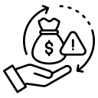
CREDIT DEFAULT SWAPS
A Credit Default Swap (CDS) is a financial derivative contract that allows one party, known as the protection buyer, to transfer the credit risk of a specific debt obligation to another party, known as the protection seller. The primary purpose of a CDS is to provide insurance or protection against the possibility of a credit event, such as a default, bankruptcy, or a significant credit downgrade, occurring with the underlying debt instrument.

Slide 41
CREDIT DEFAULT SWAPS
Here are the key features and components of a Credit Default Swap:
Reference Obligation
Protection Buyer
The CDS contract identifies a reference obligation, which is typically a specific bond or debt instrument. The protection buyer owns or holds exposure to this reference obligation.
01
02
This party seeks to protect itself from the credit risk associated with the reference obligation. It pays regular premiums (similar to insurance premiums) to the protection seller.
03
Protection Seller
The protection seller agrees to compensate the protection buyer in the event of a credit event related to the reference obligation. In exchange for this protection, the protection seller receives premium payments from the protection buyer.

Slide 42
CREDIT DEFAULT SWAPS
Notional Amount
Credit Events
The notional amount represents the face value of the reference obligation or the amount of debt being protected. It is not exchanged between the parties and serves as the basis for calculating the payments.
04
05
CDS contracts specify what constitutes a credit event. Common credit events include default, bankruptcy, failure to pay, or a significant credit downgrade of the reference obligation. When a credit event occurs, the protection seller must make a payment to the protection buyer.
06
Premiums
The protection buyer pays periodic premiums to the protection seller. These premiums are similar to insurance premiums and compensate the protection seller for assuming the credit risk. The premium amount is typically a percentage of the notional amount.

Slide 43
CREDIT DEFAULT SWAPS
Maturity Date
Settlement Terms
CDS contracts have a defined maturity date, which is when the contract expires. The buyer's credit risk protection ends on the maturity date.
CDS contracts can be physically settled or cash settled, depending on the terms of the contract. In physical settlement is when the protection seller pays the buyer the par value of the debt obligation, and the buyer gives the seller the debt obligation in return.In a cash settlement, the protection seller pays the protection buyer the difference between the notional amount and the recovery value of the reference obligation.
07
08
09
Counterparty Risk
CDS contracts involve counterparty risk, as the protection buyer relies on the protection seller to fulfill their payment obligations in the event of a credit event. Parties may require collateral or use credit support annexes (CSAs) to mitigate this risk.

Slide 44
CREDIT DEFAULT SWAPS
Trading and Liquidity
Credit Risk Transfer
CDS contracts are actively traded in financial markets, and their liquidity can vary depending on the reference obligation and market conditions.
10
11
CDS contracts provide a mechanism for transferring credit risk without the need to buy or sell the underlying debt security. They are often used for hedging credit exposures or speculating on credit events.
12
Regulation
The regulation of CDS markets and market participants varies by jurisdiction. Regulatory authorities have sought to increase transparency and reduce risks in CDS trading following the 2008 financial crisis.
CDS contracts are versatile financial instruments used by a range of market participants, including banks, hedge funds, corporations, and institutional investors, to manage and mitigate credit risk. They are a key tool for credit risk management and can be an important component of financial risk management strategies.

Slide 45

CREDIT EVENTS
Credit events are specific occurrences that trigger obligations in a Credit Default Swap (CDS) contract. These events typically represent adverse developments related to the creditworthiness of the reference obligation (the underlying debt instrument).

Slide 46
CREDIT EVENTS
The specific types of credit events can vary depending on the terms of the CDS contract, but common credit events include:
Default:
Default is one of the most common credit events in CDS contracts. It occurs when the issuer of the reference obligation fails to make a scheduled interest or principal payment on the debt, violating the terms of the bond or loan agreement.
Bankruptcy:
Bankruptcy is another significant credit event. It happens when the issuer files for bankruptcy protection, indicating its inability to meet its financial obligations. Bankruptcy can result in a significant loss for bondholders.
Failure to Pay:
This event occurs when the issuer fails to make a scheduled payment of principal or interest on the reference obligation, regardless of whether a formal default or bankruptcy has occurred. It is a broader event than default, encompassing situations where payment obligations are not met.
01
02
03

Slide 47
CREDIT EVENTS
Credit Rating Downgrade:
A credit rating downgrade event is triggered when a recognized credit rating agency (e.g., Moody's, S&P, Fitch) downgrades the credit rating of the reference obligation to a level specified in the CDS contract. The downgrade must typically meet certain criteria, such as a minimum rating threshold.
Restructuring:
Restructuring events involve changes to the terms of the reference obligation that are adverse to the bondholders. This can include changes to the maturity, interest rate, or principal amount of the debt. Restructuring events can be complex and are typically defined in detail within the CDS contract.
Acceleration:
Acceleration events occur when the terms of the reference obligation are altered in a way that accelerates the maturity of the debt. This often happens when a default or bankruptcy occurs, and bondholders demand full repayment.
04
05
06

Slide 48
CREDIT EVENTS
Moratorium:
A moratorium event is declared when the issuer of the reference obligation imposes a temporary halt or delay on payments to bondholders, typically during a financial crisis or when seeking to negotiate new terms.
Repudiation of Obligations:
This event occurs when the issuer explicitly refuses to acknowledge or honor its debt obligations, even if payment has not yet been due.
Cessation of Payments:
This event is triggered when the issuer stops making payments on its debt obligations, which may or may not be associated with a formal default.
07
08
09

Slide 49
CREDIT EVENTS
It's important to note that the specific credit events covered in a CDS contract can vary based on the contract's terms and negotiation between the parties involved. Additionally, the terms and definitions of these events are usually detailed in the contract's documentation and may incorporate criteria from recognized credit rating agencies.
The occurrence of a credit event in a CDS contract typically leads to a payment from the protection seller to the protection buyer, providing compensation for the credit risk associated with the reference obligation. The precise terms and triggers for these events should be carefully reviewed within the CDS contract to ensure clarity and understanding.

Slide 50

BANKRUPTCY: EXAMPLE
15th September 2008
$639 bn
In Assets
$619 bn
In Debt
Largest victim of the subprime mortgage crisis
$10 trillion
Erosion in Global Market Capitalization
‹#›

Slide 51

RESTRUCTURING: EXAMPLE
$600 mn
Compensation
$154 mn
Debt Cancelled
$7.2 Billion
Debt Restructuring Plan

Slide 52
DERIVATIVES - CREDIT DEFAULT SWAPS - EXAMPLE
01
Terms of the CDS:
At the beginning of Year-1, Party A purchases a CDS Derivative contract from Party B as protection against the possibility of default by Company XYZ's issued Bonds.
Notional Principal: $10 million
Counter Parties : Party A & Party B
CDS Buyer : Party A
CDS Seller : Party B
Reference Entity: Company XYZ Ltd
Reference Entity Obligation: XYZ' Ltd issued Unsecured Bonds
Reference Entity Credit Rating : AAA+
Premium Payment Frequency: Quarterly upfront
Term/Maturity of CDS: 3 years
Survival Rate: 95%; Probability of Survival during the CDS Term
Recovery Rate: 40%; The estimation of recovery amount in the event of default
CDS Premium : 2% Per Annum but payable Quarterly

Slide 53
DERIVATIVES - CREDIT DEFAULT SWAPS - EXAMPLE
02
Premium Calculation & Payment:
The survival rate is 95%, meaning there is a 95% probability that Company XYZ Ltd will not Default during the CDS term i.e 5% probability of Default by the Reference Entity Company XYZ Ltd.
CDS Premium depends on the credit risk associated with the Reference Entity & Reference Obligation i.e Probability of Default & Recovery Rate
In this example, the premium rate is set at 200 basis points (2%) per annum, payable quarterly.
Premium Payment per quarter = (Notional Principal * Premium Rate) / 4
Year-1; Quarter-1:
At the beginning of Quarter-1 of Year-1, The premium for Q1 is calculated as follows:
The premium for Quarter-1 of Year-1 is calculated as follows:
Premium Payment = ($10,000,000 * 2% / 4) = $50,000 per Quarter
Party A pays $50,000 to Party B as the premium for Quarter-1.

Slide 54
DERIVATIVES - CREDIT DEFAULT SWAPS - EXAMPLE
02
Premium Calculation & Payment:
Year-1; Quarter-2:
At the beginning of Quarter-2 of Year-1, The premium for Q2 is calculated as follows:
Premium Payment = ($10,000,000 * 2% / 4) = $50,000
Party A pays $50,000 to Party B as the premium for Q2.
Year-1; Quarter-3:
At the beginning of Quarter-3 of Year-1, The premium for Q3 is calculated as follows:
Premium Payment = ($10,000,000 * 2% / 4) = $50,000
Party A pays $50,000 to Party B as the premium for Q2.

Slide 55
DERIVATIVES - CREDIT DEFAULT SWAPS - EXAMPLE
03
Credit Event Occurrence:
In Quarter-3, Company XYZ encounters financial difficulties and defaults on its bonds. This event triggers the CDS contract.
The market value of the bonds is equal to 40% recovery rate, indicating that in the event of default, the bondholders can expect to recover 40% of the face value of the bonds hence there is a financial loss of 60% of Face Value
Party A, as the protection buyer, experiences a credit event (default) and is entitled to a payout from Party B, the protection seller.
The payout to Party A is calculated as follows: Payout = (Notional Principal *(1- Recovery Rate) )= ($10,000,000 * 60%) = $6,000,000
Party B, the protection seller, must pay $6,000,000 to Party A as compensation for the credit event (Company XYZ's default).

Slide 56
DERIVATIVES - CREDIT DEFAULT SWAPS - EXAMPLE
03
Credit Event Occurrence:
Q4 onwards :
Since the CDS contract has already triggered due to default, no further premium payments are made.
In this example:
Party A, the protection buyer, paid premiums to Party B, the protection seller, over the first three quarters of Year-1.
When Company XYZ defaulted in Quarter-3, the credit event occurred, and Party A received a payout of $6,000,000 from Party B, which is based on the recovery rate of 40% as the Loss is 60%.

Slide 57
TYPES OF CREDIT DEFAULT SWAP
It considers the debt obligation of only one company as its reference obligation
It considers the debt obligations of more than one company as its reference obligation.
Single Name
Basket
Naked
When the buyer of the protection does not hold the debt obligation. Typically CDS Buyer bets on a reference obligation, which they does not owns, speculation trade.

Slide 58
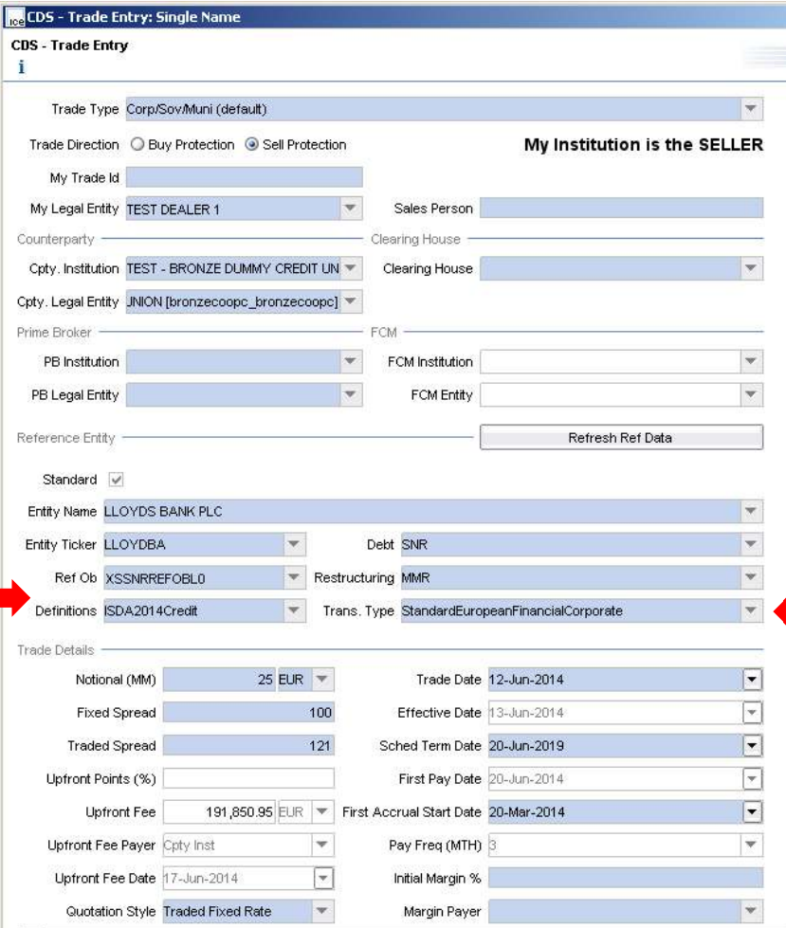
DERIVATIVES - SWAPS
Credit Default Swaps – Trade Economics

Slide 59

Its time to play KAHOOT Quiz
Click here to start the quiz

Slide 60



THANK YOU !!!
Contact us today! https://imarticus.org/

